Slide 1
Visualisation for Data Science
Predict
Notes:
Inspect the increment and collaboratively update the product backlog.
Questions to ask:
Did the team meet the sprint forecast?
Was there work added or removed during the middle of the sprint?
Did any work not get completed within the sprint?
If so, why?
Agenda for a Sprint Review
- Product Owner identifies what has been done and what has not been done
Team talks about the Sprint:
- What went well
-Problems that arose
-How they solved those problems
-Demonstrates completed work/Product Backlog Items
-Answers any questions
Product Owner:
-discusses current snapshot of Product Backlog and Roadmap
-projects likely completion dates with various completion rate (or velocity) assumptions
All attendees then discuss previous agenda items and how they affect what to do next. The Sprint Review also provides vital input into the impending Sprint Planning Meeting.

Slide 2
Predict Summary
In this predict we will use PowerBI to connect to new data sources related to Eskom’s power generation, change the data source locations, and create new visuals to derive the insight required to appropriately answer several MCQs.
Theme
Objective
Outcome
Data Sourcing
Changed the source of the PowerBI data files to the path on your local machine
Sourced additional Eskom Excel data files
Experiment with different PowerBI data connectors
1
Data Formatting
Filled the missing values of the Eskom Excel files with the approximate feature averages
Created feature relations
Clean, transform and format sourced data
2
Data Visualisation
Added various visuals including:
Slicers,
Cards, and
Line charts
Fix ‘broken’ dashboard and create new visuals
3
© Explore Data Science Academy

Slide 3
Agenda
01
Problem Introduction
02
Connecting to the Data
03
Sourcing Additional data and Setting Relationships
04
Creating Visuals
© Explore Data Science Academy

Slide 4
Problem Introduction: The National Energy Crisis
In this predict we will be using Eskom data to build an informative dashboard using Microsoft Power BI.
The dashboard with its underlying reports will then be used to derive insight into the current South African energy crisis and answer multiple choice questions.
You will be supplied with a ‘broken’ dashboard and the underlying data
Your task is to:
1) correctly source the data
2) fix the relationships, and
3) create the appropriate visuals
The reports you have created will be used to answer the multiple choice questions at the end of this predict
© Explore Data Science Academy

Slide 5
Agenda
01
Problem Introduction
02
Connecting to the Data
03
Sourcing Additional data and Setting Relationships
04
Creating Visuals
© Explore Data Science Academy

Slide 6
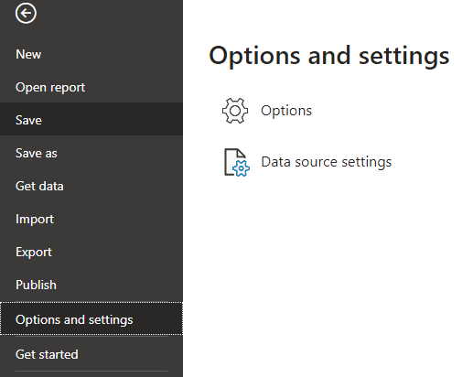
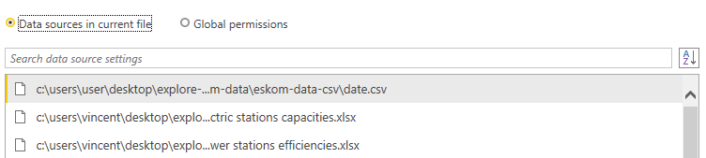
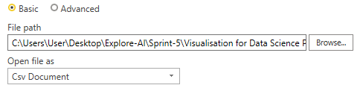
Connecting to the Data
In this predict we will be using XLSX and CSV files to source the data.
Step 1
Step 2
Step 3
Download and unzip the file containing the XLSX and CSV files:
Eskom-Data-Power-BI-Predict.zip
Download the Power BI file -
Eskom-Visualisation4DS-student-version.pbix containing the broken ‘dashboard’.
Change the data source directory for each file in the Eskom-Data-Power-BI-Predict
© Explore Data Science Academy

Slide 7
Agenda
01
Problem Introduction
02
Connecting to the Data
03
Sourcing Additional data and Setting Relationships
04
Creating Visuals
© Explore Data Science Academy

Slide 8
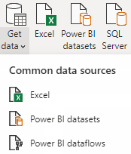
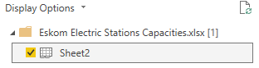
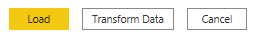
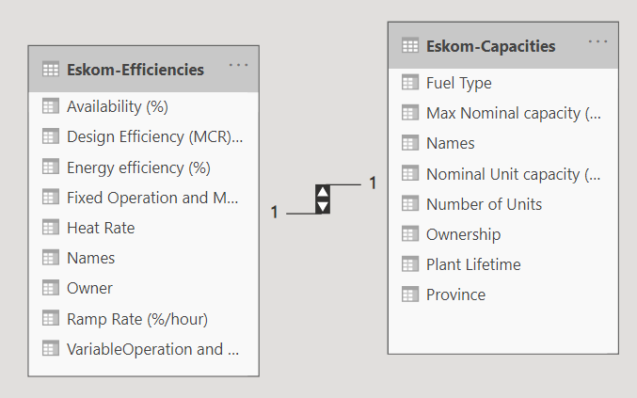
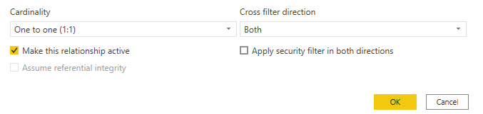
Sourcing Additional data and Setting Relationships
When opening the ‘broken’ dashboard you will note that the ‘Capacity and Efficiency’ visuals are not working. This is because the datasets for these visuals and their corresponding relationships are not set up. To properly source the data and set up the relationships we will be following the steps below:
Steps for connecting to the Eskom Capacities and Efficiencies Datasets
Source Data
Use the Power BI ‘Get Data’ Excel connector and connect to the Eskom Electric Stations Capacities.xlsx dataset
Select ‘Sheet2’
Click on ‘Load’
Repeat steps 1-3 for the Eskom power stations efficiencies.xlsx dataset
Rename the Efficiencies dataset to ‘Eskom-Efficiencies’ and the Capacities dataset to ‘Eskom-Capacities’
Create a 1-1 relationship between the ‘Names’ column of the Eskom-Capacities and Eskom-Efficiencies datasets
Create Relationship
© Explore Data Science Academy

Slide 9
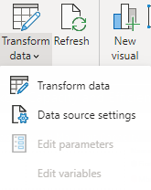
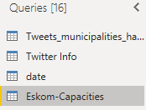
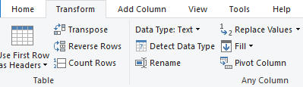
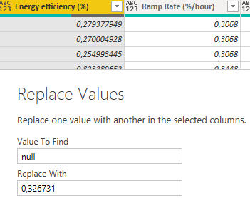
Sourcing Additional data and Setting Relationships
With the Eskom Efficiencies and Capacities datasets now sourced and the relationships created, the next steps are concerned with cleaning the data to get it in a workable format. To do this, we are going to replace the empty and null value columns with the column average
Steps for cleaning the Capacities Dataset
Access the Power Query Editor via the ‘Transform Data’ button and navigate to the Eskom-Capacities dataset (you will notice a lot of columns with ‘null’ entries)
Remove ‘Steam Capacity’ and ‘Column10’
For the ‘max nominal capacity (MW)’ column - fill the missing value with 1352
Select the ‘Plant Lifetime’ column and replace ‘null’ values with 50
For the ‘Nominal Unit capacity (MW)’ column - fill the missing values with 510
For the ‘Number of Units column’ - fill the missing values with 5
Access Datasets and Data Functions
Replace ‘null’ values
© Explore Data Science Academy

Slide 10
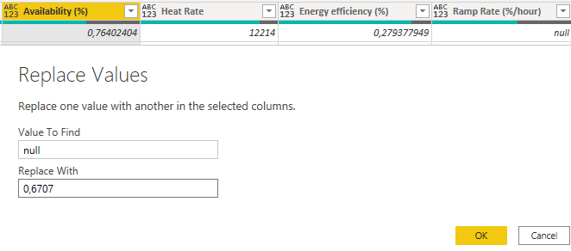
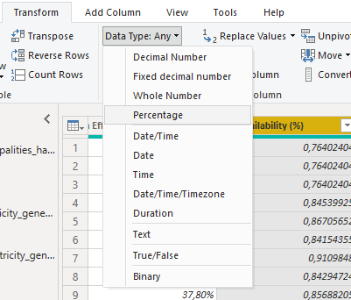
Sourcing Additional data and Setting Relationships
With the Eskom Efficiencies and Capacities datasets now sourced and the relationships created, the next steps are concerned with cleaning the data to get it in a workable format. To do this, we are going to replace the empty or null value columns with the column average
Steps for cleaning the Efficiencies Dataset
Remove ‘Column10’
For ‘Fixed Operation and Maintenance Cost’ - fill the missing values with 188
For ‘Variable Operation and Maintenance Cost’ - fill the missing values with 45
For ‘Ramp Rate per hour’ - fill the missing values with .3068
For ‘Energy Efficiency’ - fill the missing values with .326731
For ‘heat rate’ - fill the missing values with 10589.22
For ‘availability’ - fill the missing values with .6707 (approx. average)
For ‘design efficiency’ - fill the missing values with .350889
Set the data types for all columns i.e. %, whole number, etc.
Remove the bottom 67 rows and the top 1 row
Replace ‘null’ values
Set the Data Type
© Explore Data Science Academy

Slide 11
Agenda
01
Problem Introduction
02
Connecting to the Data
03
Sourcing Additional data and Setting Relationships
04
Creating Visuals
© Explore Data Science Academy

Slide 12
Infrastructure Dashboard
The infrastructure dashboard gives us insight into attributes of each station. Using Power BI slicers and filters we can draw correlations between station attributes, and explore and analyse this dataset in-depth.
Using what you’ve learnt up to this point, you are tasked to restore the supplied ‘broken’ infrastructure dashboard. You may use the below standing as guidance in your quest to rebuild the dashboard
Slicers
Cards
Table
Visuals
Add the feature ‘Avg. of nominal_capacity_MW’ to the column values field of the line and stacked column chart
Add an average electricity generated in MW card
Add the features ‘station_name’ and ‘count of id’ to the table
Add a location slicer
Add the feature ‘commissioned_year_end’ to the line values field of the line and stacked column chart
Add a total number of stations card
Add the features ‘nominal_capacity_MW’ and ‘province’ to the table
Add a station slicer
Add a summary of stations card.
Hint: Count of station_name feature and the status feature might be helpful
Add the features ‘operator_name’ and ‘installed_capacity’ to the table
Add the feature ‘commission_year_start’ to the tooltips field of the line and stacked column chart
Add a station type slicer
© Explore Data Science Academy

Slide 13
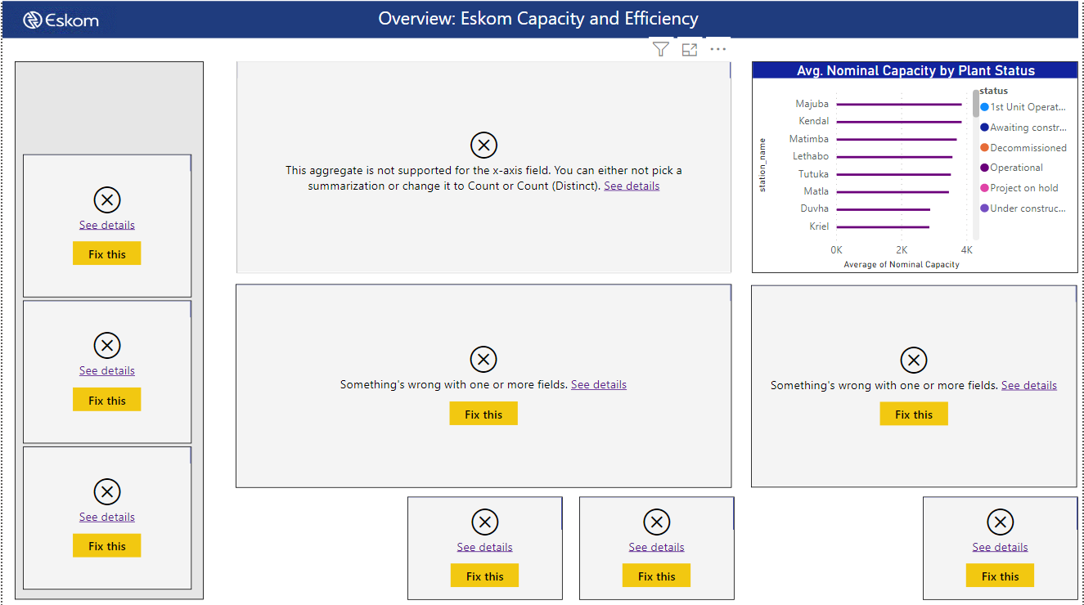
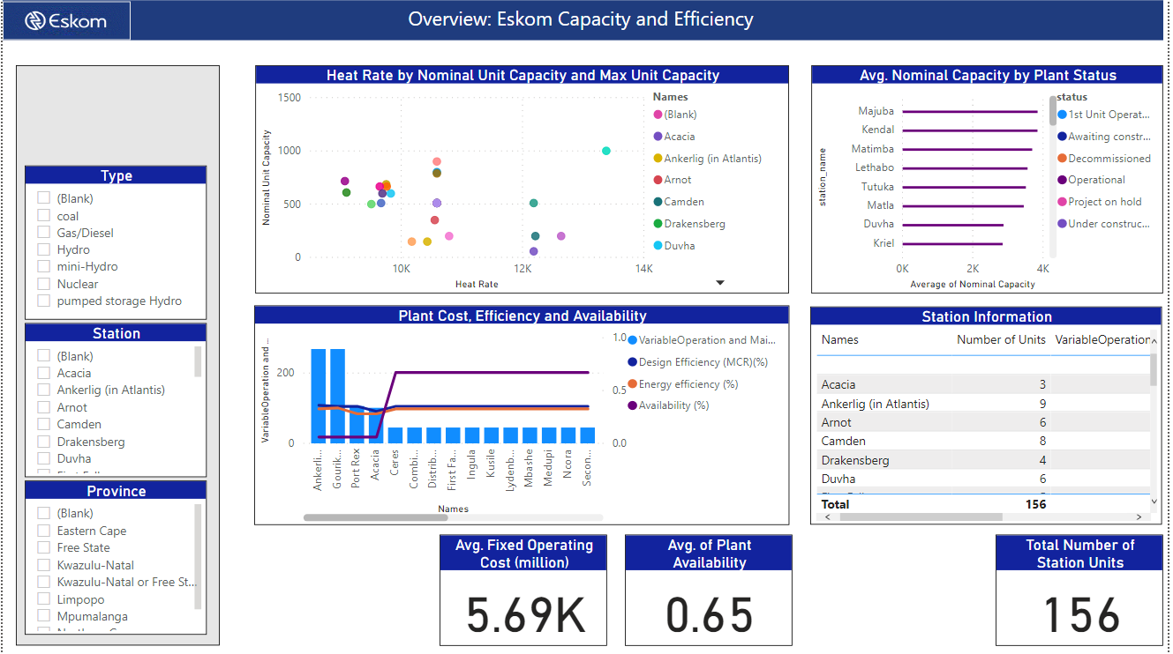
Capacity and Efficiency Dashboard
The Eskom capacity and efficiency dashboard is aimed at providing information on individual station performance.
Guidelines for fixing the Eskom Capacity and Efficiency dashboard
Before data is sourced, cleaned and relationships are created
Slicers
Add a ‘number of units’ slicer to the dashboard. Set the slicer type as between
Cards
Add the following cards to the report:
Avg. of Ramp Rate (%/hr)
Avg. of variable operations and maintenance costs
After data is sourced, cleaned and relationships are created
Visuals
For the scatter chart, add the feature ‘Max nominal capacity (MW)’ to the size column
For the clustered bar chart add the feature ‘status’ to the visualisations legend field

Slide 14
Twitter Dashboard
The twitter dashboard summarises Eskom mentions (@) and tags (#) over a defined period
Municipality slicer
Hashtags slicer
Add a municipality slicer of type ‘dropdown’ to the dashboard
3
4
Add a hashtags slicer of type ‘dropdown’ to the dashboard
Date slicer
Multirow card
Add a date slicer of type ‘between’ to the dashboard
2
5
Add the feature ‘count of hashtags’ to the multi-row card visual
Import visuals
Addition of Tweets feature
If you have not yet done so – click on the ‘Get more visuals’ button and download the WordCloud 2.0 visual and the Scroller visual
1
6
To the table add the feature ‘Tweets’. Insert this feature in the table values column

Slide 15

Predict-related FAQs
This page will be updated periodically with common predict-related questions which may arise during the Sprint. Consider consulting this space before asking your course facilitator a question.

